Slide 1

CS 6140:
Machine Learning
Presented by: Dr. Tala Khoei

Slide 2
Working on Images

Slide 3

Please Refer to Week 2 for Details on Image
Processing

Slide 4
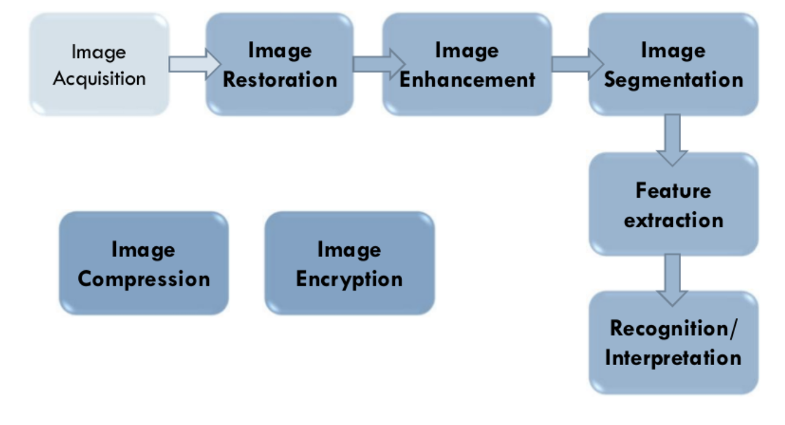
Fundamentals of Image Processing

Slide 5

Why do we process images?
It has been developed to deal with 3 major problems
To improve the image data to suppress the unwanted distortions.
To enhance some features of the input image.
As a means of translation between the human visual system and digital imaging devices.

Slide 6
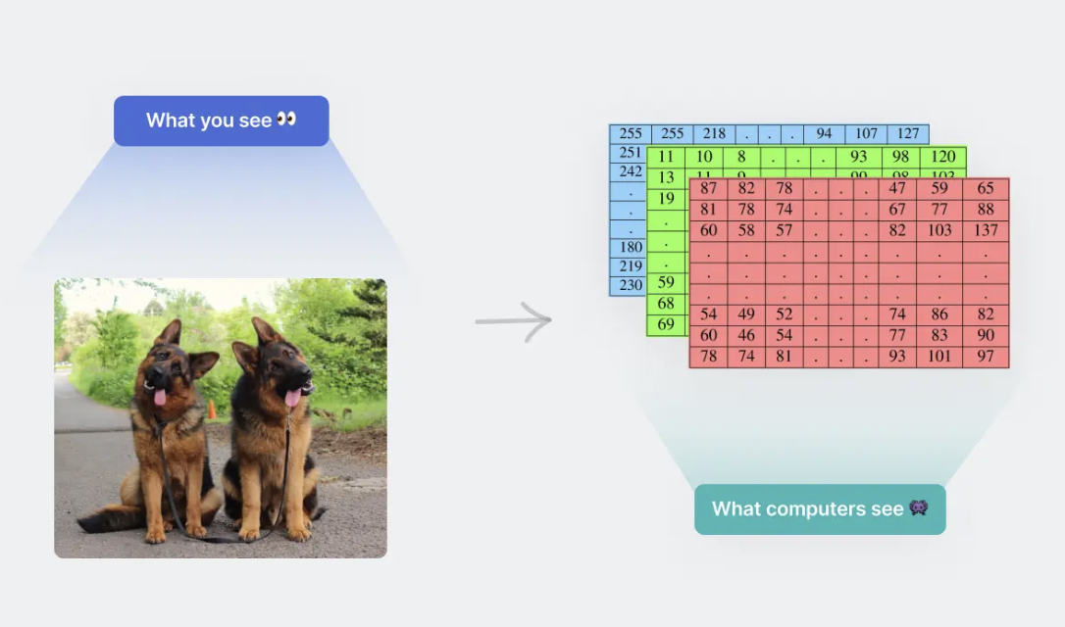
Digital image
Digital images are interpreted as 2D or 3D matrices by a computer, where each value or pixel in the matrix represents the amplitude, known as the “intensity” of the pixel.
Typically, we are used to dealing with 8-bit images, wherein the amplitude value ranges from 0 to 255.

Slide 7
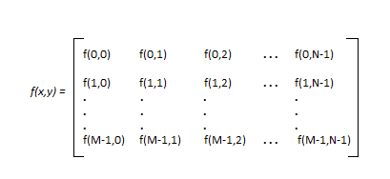
As we know, images are represented in rows and columns we have the following syntax in which images are represented:
Every element of this matrix is called image element , picture element , or pixel.

Slide 8
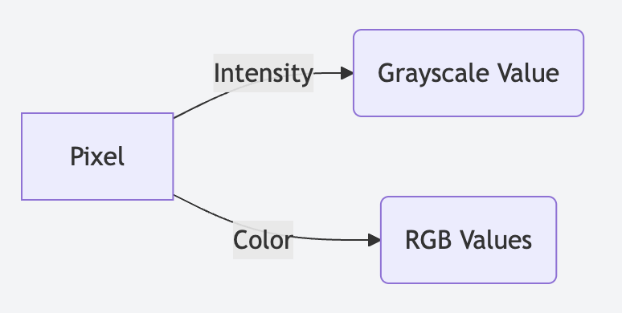
Pixel values represent the intensity or color information of an image at a particular location.
In digital images, pixel values are typically represented as integers or floating-point numbers. The significance of pixel values lies in their ability to capture the visual information of an image.
In a digital image, each pixel is associated with a set of values that describe its color or intensity. For example, in a grayscale image, each pixel is represented by a single value that indicates its intensity, ranging from 0 (black) to 255 (white).

Slide 9
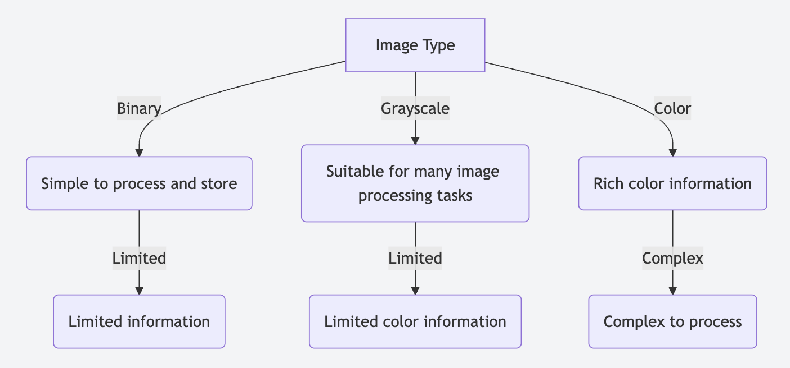

Slide 10
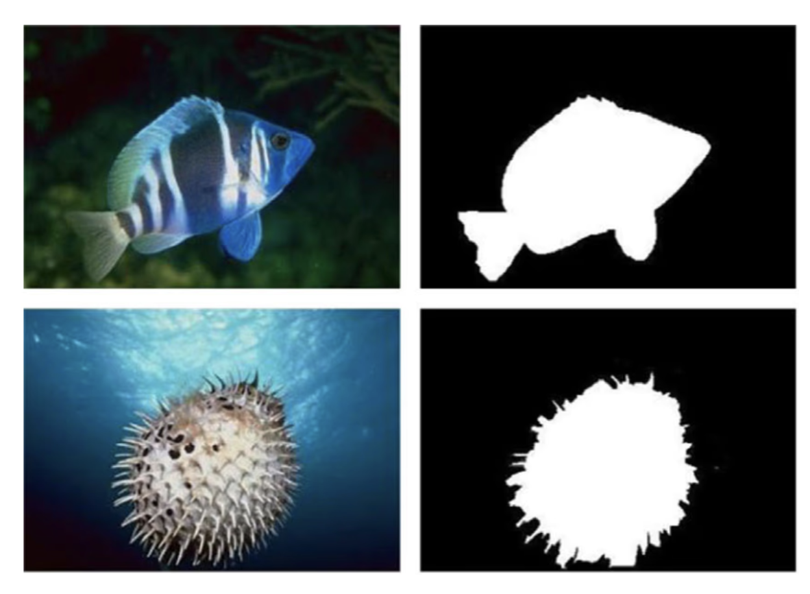
1. Binary Image
These are images where each pixel is either 0 or 1, representing black or white.
Images that have only two unique values of pixel intensity- 0 (representing black) and 1 (representing white) are called binary images.

Slide 11
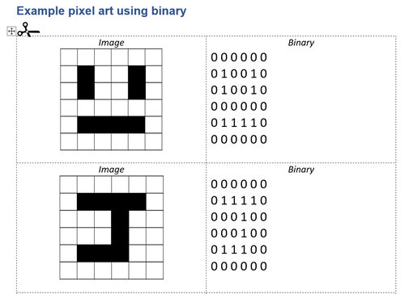

Slide 12
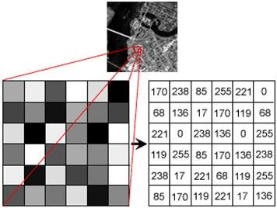
2. Grayscale Image
These are images where each pixel is represented by a single value, indicating its intensity.
Grayscale or 8-bit images are composed of 256 unique colors, where a pixel intensity of 0 represents the black color and pixel intensity of 255 represents the white color. All the other 254 values in between are the different shades of gray.

Slide 13
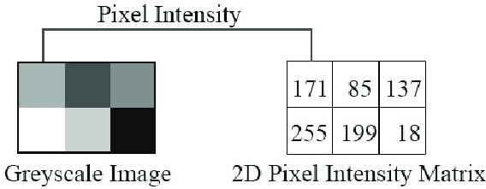

Slide 14
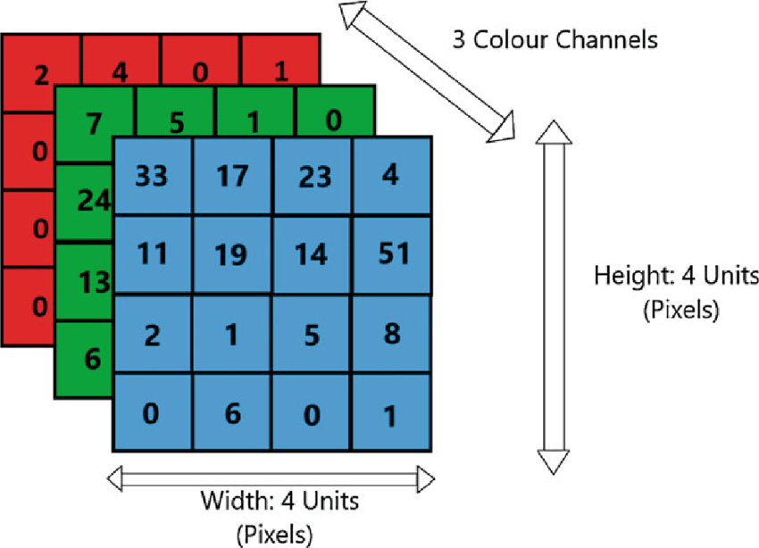
3. RGB Color Image
The images we are used to in the modern world are RGB or colored images which are 16-bit matrices to computers. That is, 65,536 different colors are possible for each pixel.
An RGB image refers to an image where each pixel is defined by the amount of red, green, and blue colors. It is created by using three different colormaps for these colors and visualized as a 2-D matrix.
An RGB image is represented by a 3D array, where each pixel's color is defined by three values: Red, Green, and Blue (RGB). These values, typically ranging from 0 to 255, represent the intensity of each color component.

Slide 15
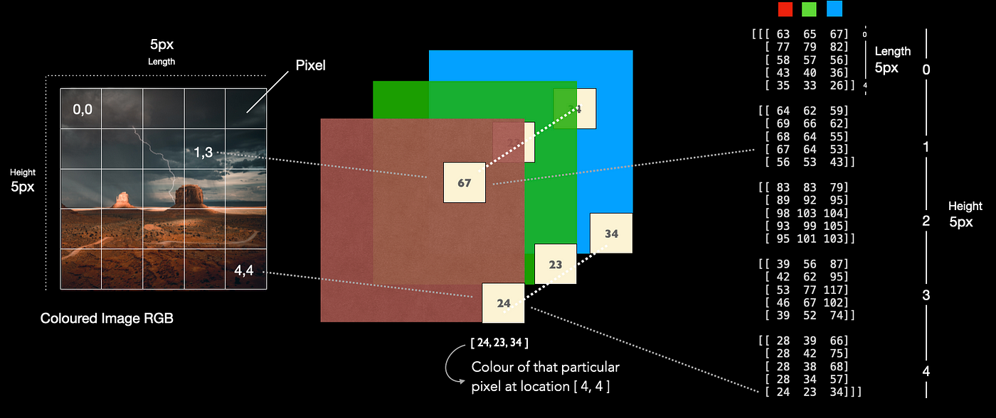

Slide 16
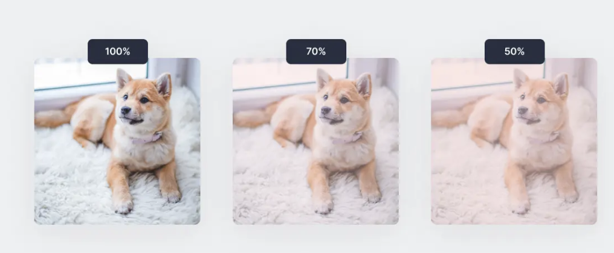
4. RGBA Image
RGBA images are colored RGB images with an extra channel known as “alpha” that depicts the opacity of the RGB image.
Opacity ranges from a value of 0% to 100% and is essentially a “see-through” property. Opacity in physics depicts the amount of light that passes through an object.
Note: The opacity of an image is how transparent or opaque it is.

Slide 17
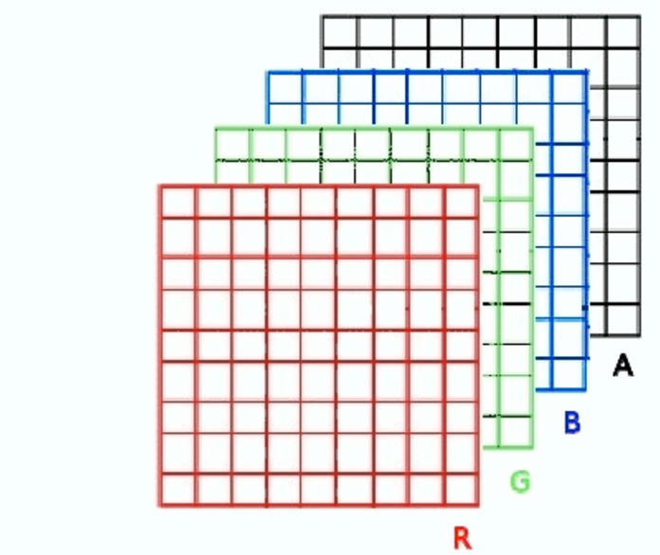

Slide 18
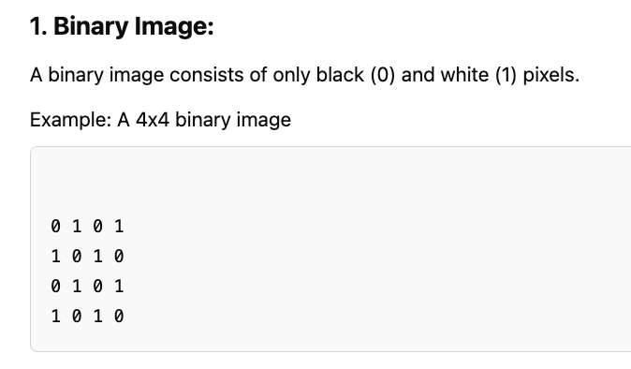
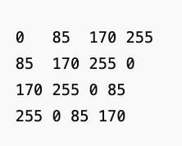
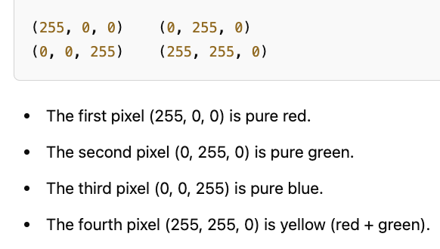
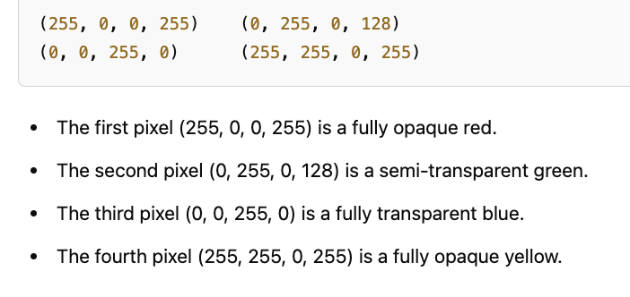
2. Grayscale Image:
A grayscale image has pixels with values ranging from 0 (black) to 255 (white), with shades of gray in between.
Example: A 4x4 grayscale image:
3. RGB Color Image:
In an RGB image, each pixel has three components (Red, Green, Blue), each ranging from 0 to 255.
Example: A 2x2 RGB image
4. RGBA Color Image:
An RGBA image has four components (Red, Green, Blue, Alpha), where the Alpha channel controls transparency.
Example: A 2x2 RGBA image:

Slide 19
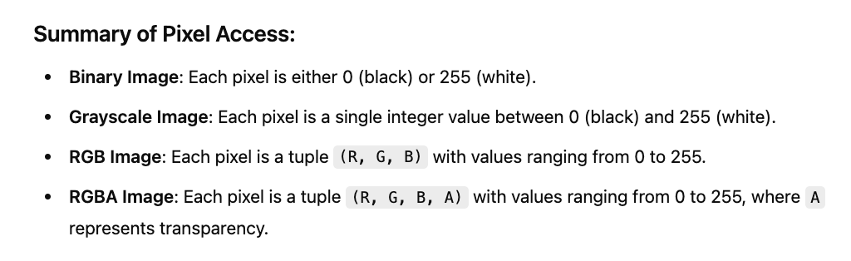
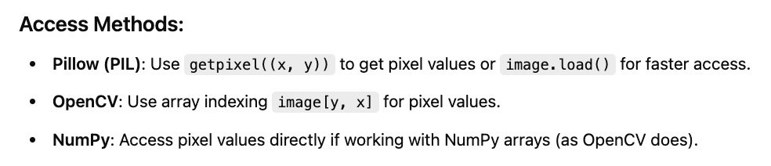

Slide 20
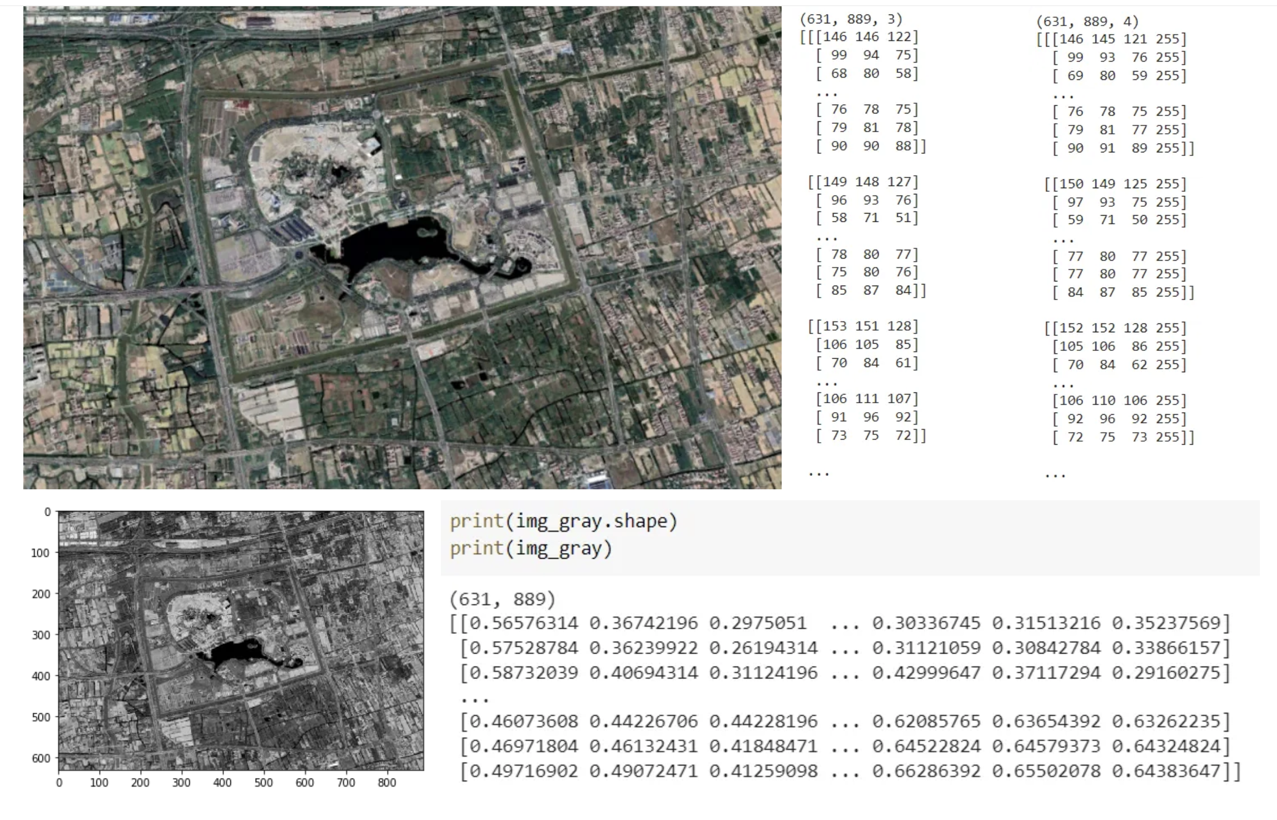
Note:
Image processing of color images generally involves converting the image to grayscale, noise removal, segmentation, feature extraction, and modeling.

Slide 21
Introduction to Convolutional Neural Networks

Slide 22
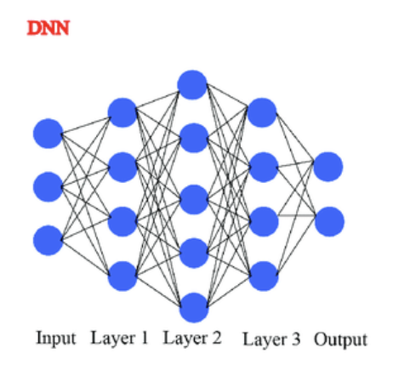
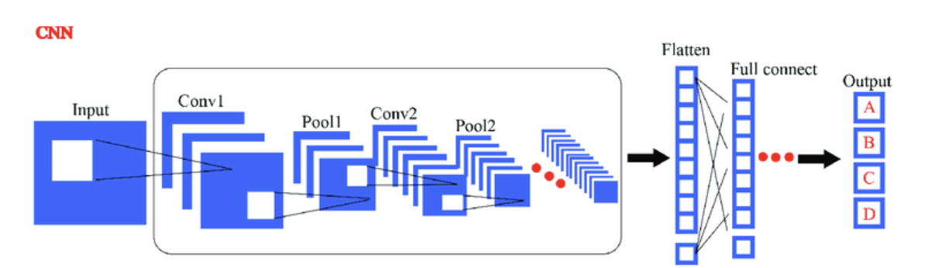
What is a Convolutional Neural Network (CNN)?
A Convolutional Neural Network (CNN) is a type of deep learning model specifically designed to work with structured grid data like images.
CNNs are especially good at tasks like image classification, object detection, and facial recognition.
The power of CNNs lies in their ability to automatically detect patterns and features in images, making them ideal for visual data analysis.

Slide 23
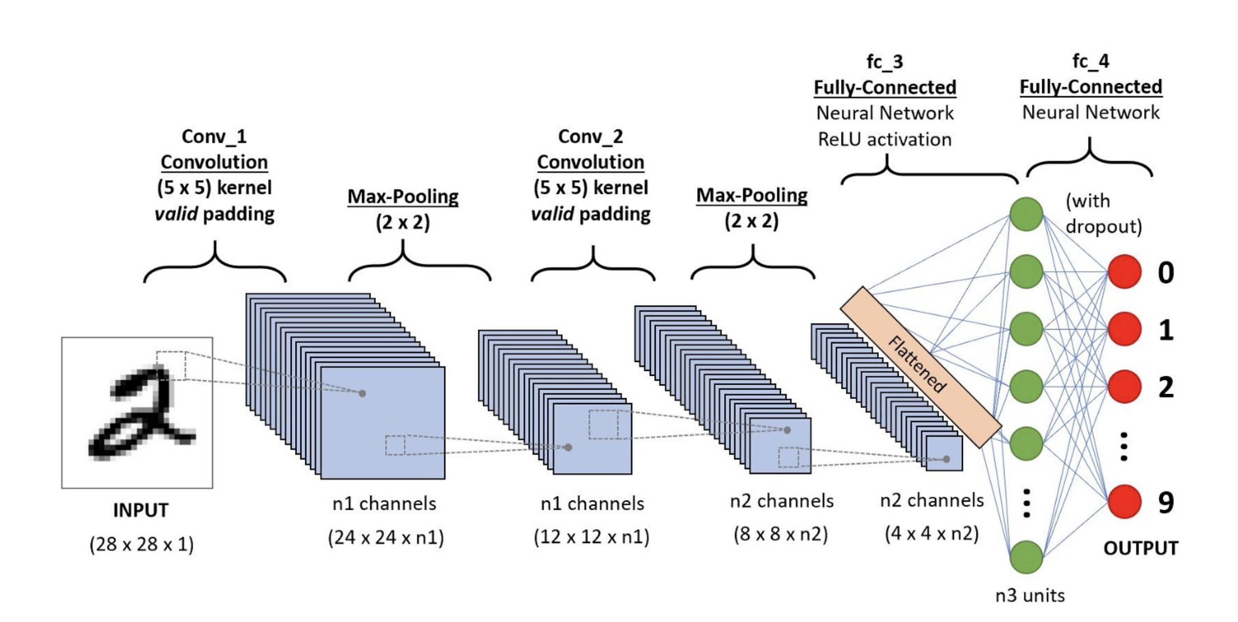

Slide 24
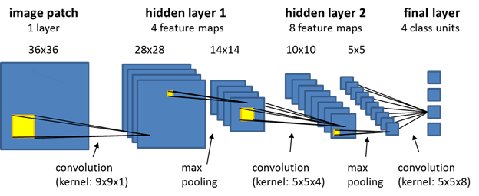
Why do we need CNNs? (Limitations of traditional DNNs for images)
Traditional deep neural networks (DNNs), struggle with image-related tasks due to their inefficiencies in handling high-dimensional data.
Another major limitation of traditional DNNs is their poor ability to generalize across spatial transformations. If an object in an image shifts slightly, a fully connected network may fail to recognize it, as it does not have a built-in mechanism for translation invariance.
Traditional DNNs tend to overfit due to the excessive number of parameters, especially when trained on limited datasets.

Slide 25
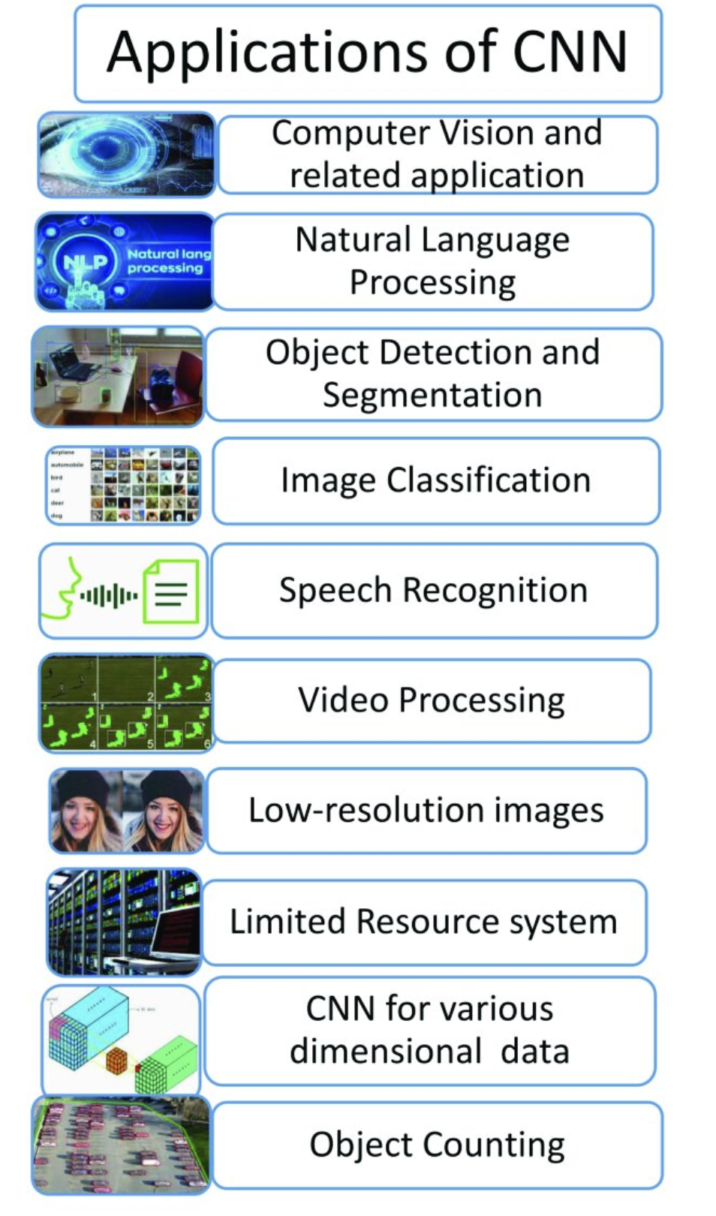

Slide 26
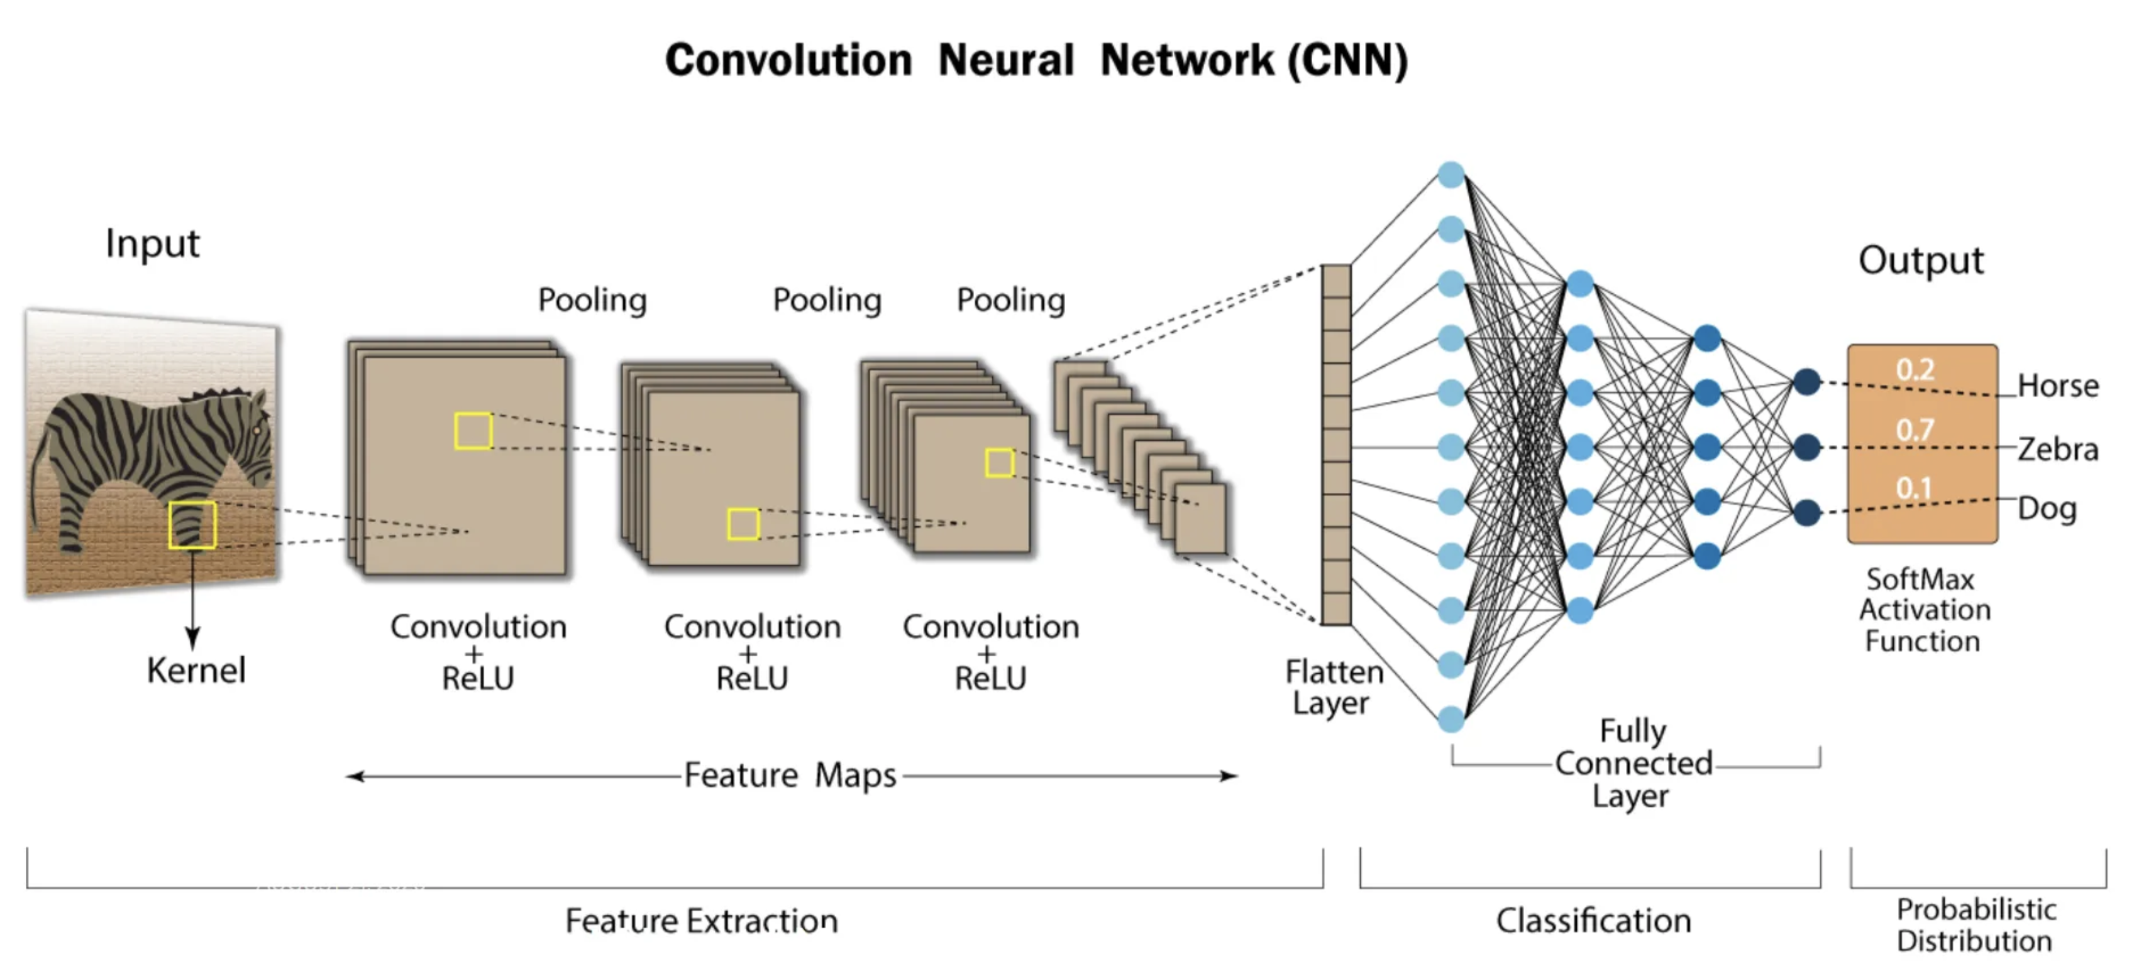
Architecture of CNN
Input Layer
Convolutional Layer
Activation Function (ReLU)
Pooling Layer (Max/Average Pooling)
Fully Connected Layer (FC Layer)
Output Layer

Slide 27
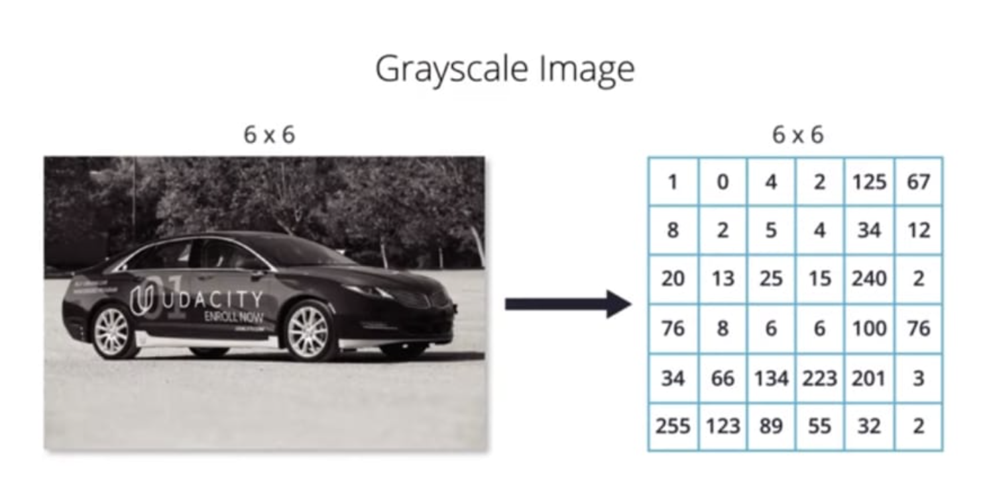
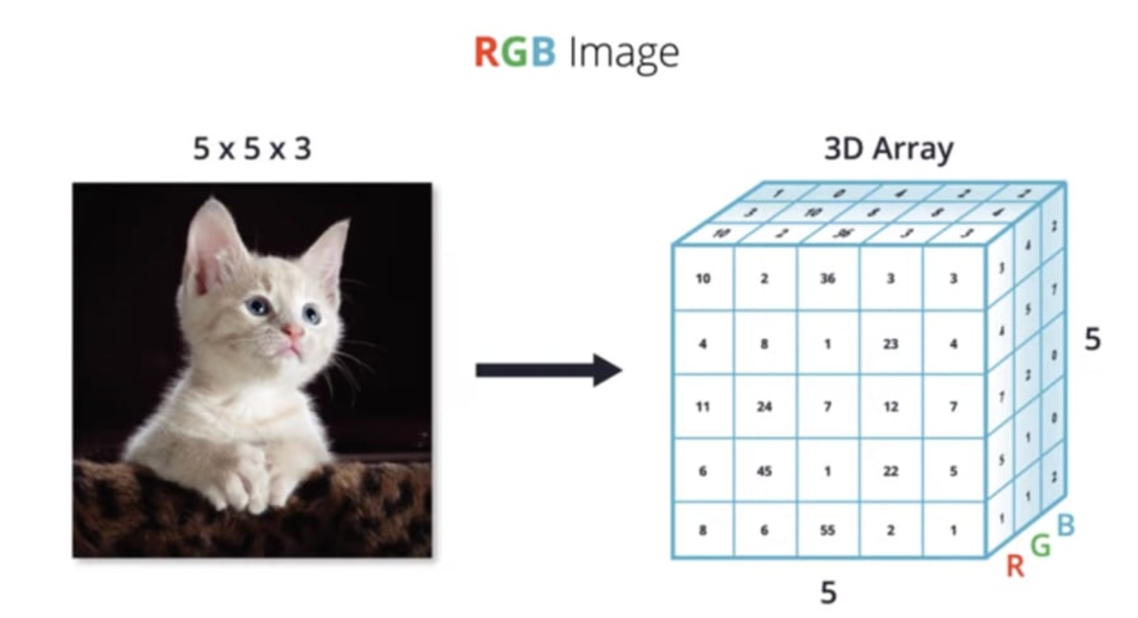
First Layer: Input Layer
In a Convolutional Neural Network (CNN), the input layer is the first component that handles the raw input data, usually in the form of images/videos.
The input layer is primarily responsible for receiving the image data and passing it on to the next layers for processing.
In the case of an image, the input layer typically takes the form of a 2D grid, where each grid cell corresponds to a pixel in the image.

Slide 28
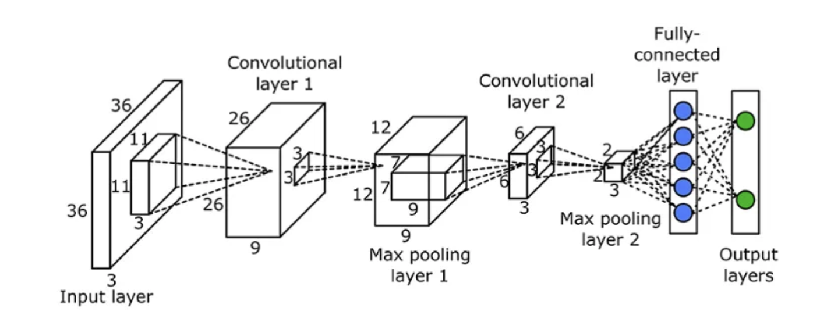
Second Layers: Convolutional Layers
The convolutional layer is responsible for extracting features from the input image.
It performs a convolution operation on the input image, where a filter or kernel is applied to the image to identify and extract specific features.

Slide 29

A convolutional layer is the core building block of a CNN. Its primary function is to extract spatial features from input image data using learnable filters (kernels).
This process entails the application of specialized filters known as kernels, that traverse through the input image to learn complex visual patterns.
The process of convolution is that we pass the filter to each pixel in an image, we multiply the corresponding pixels and then we calculate the sum, such sum making the new pixel. We repeat the process until the filter is slid over all image pixels.

Slide 30
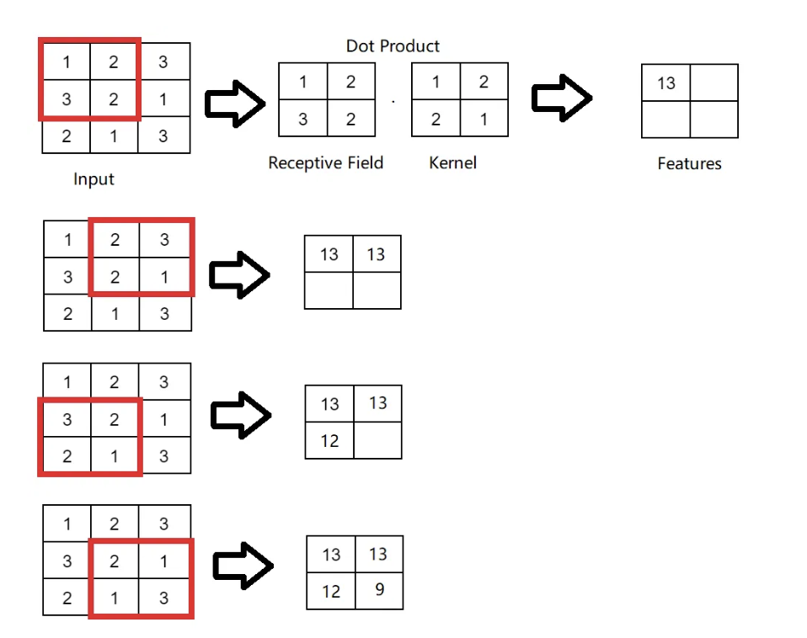
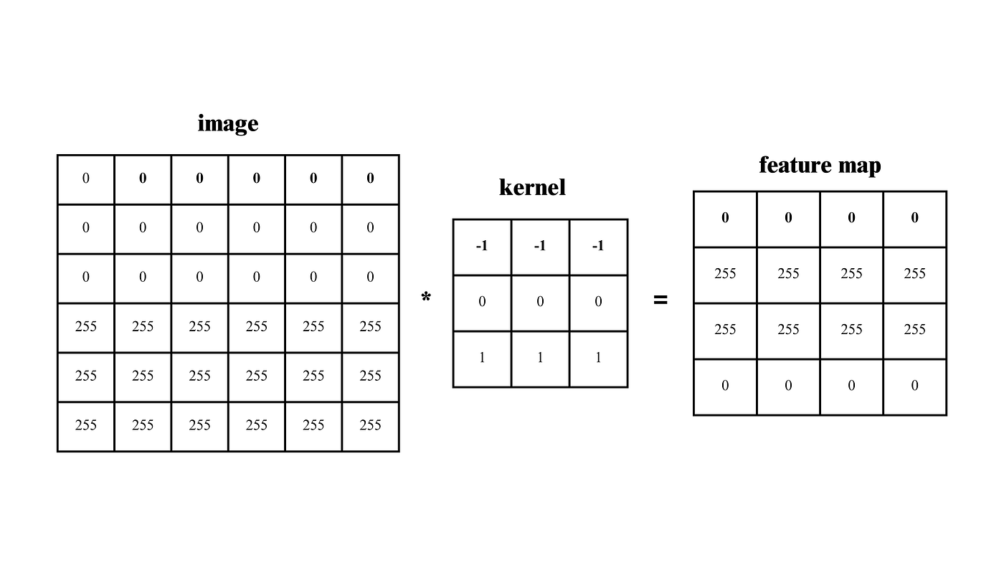
Filters/Kernels
Convolutional filters, also called kernels are designed to detect specific patterns or features in the input data.
For example, in image processing, filters might be designed to detect edges, corners, or textures.
They are essentially small matrices of numbers. These filters move across the image performing element-wise multiplication with the part of the image they cover, extracting features such as edges, textures, and shapes.

Slide 31

Kernel Operation

Slide 32
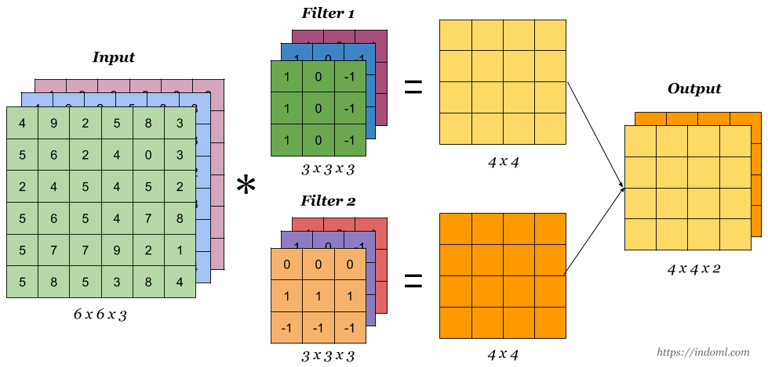
Multiple Feature Maps (Multiple Output Channels)

Slide 33
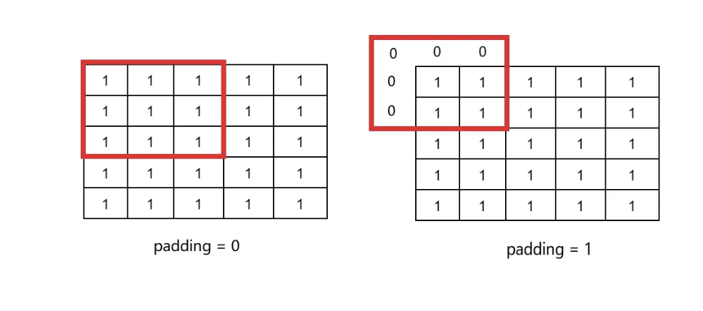
Padding
Padding in a convolutional neural network (CNN) is the process of adding extra pixels around the input image before performing convolutions.
Padding is important for preserving the spatial information of the image and ensuring accurate feature extraction.
padding is a technique used to preserve the spatial dimensions of the input image after convolution operations on a feature map.

Slide 34
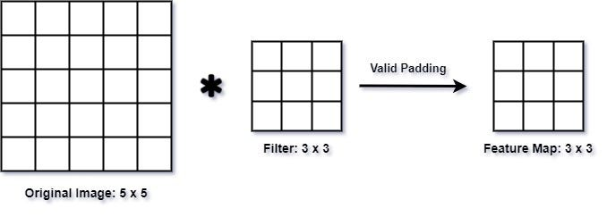
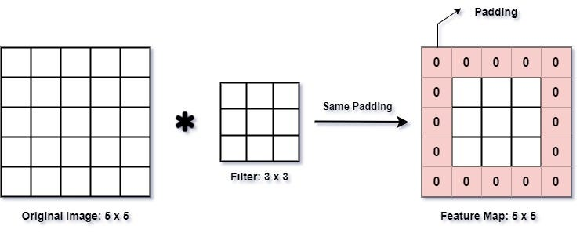
This can be done in two ways:
Valid Padding:
No padding is added to the input feature map, and the output feature map is smaller than the input feature map.
This is useful when we want to reduce the spatial dimensions of the feature maps.
Same Padding:
Padding is added to the input feature map such that the size of the output feature map is the same as the input feature map.
This is useful when we want to preserve the spatial dimensions of the feature maps.

Slide 35
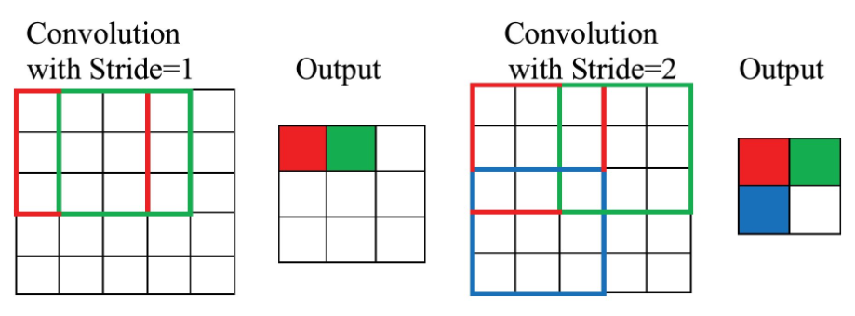
Stride
Stride is a parameter that dictates the movement of the kernel, or filter, across the input data, such as an image.
When performing a convolution operation, the stride determines how many units the filter shifts at each step. This shift can be horizontal, vertical, or both, depending on the stride's configuration.
For example, a stride of 1 moves the filter one pixel at a time, while a stride of 2 moves it two pixels. A larger stride will produce a smaller output dimension, effectively down sampling the image.

Slide 36
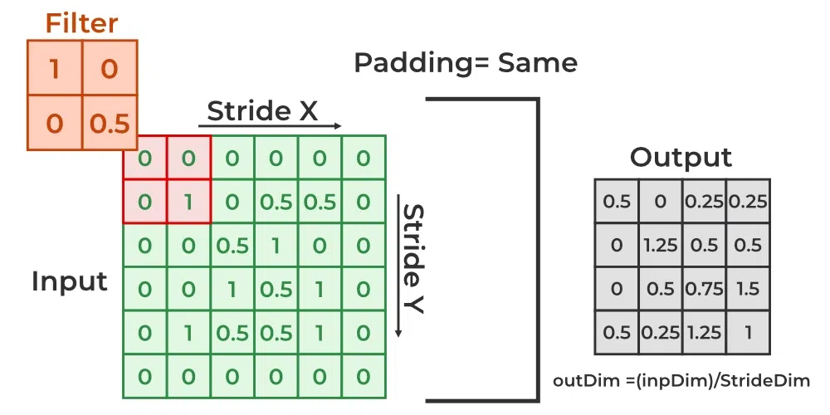

Slide 37
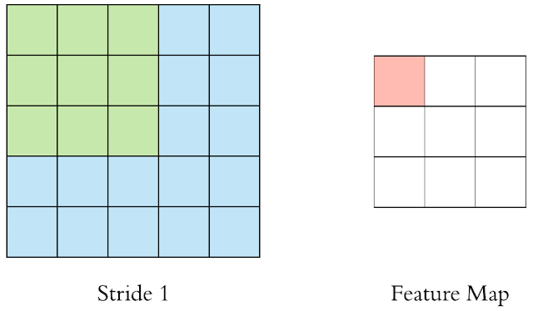
Key points about Strides
A stride of 1 means the filter moves one pixel at a time, resulting in high overlap and larger feature maps.
A stride greater than 1 skips pixels, producing smaller feature maps and reducing computational cost.

Slide 38
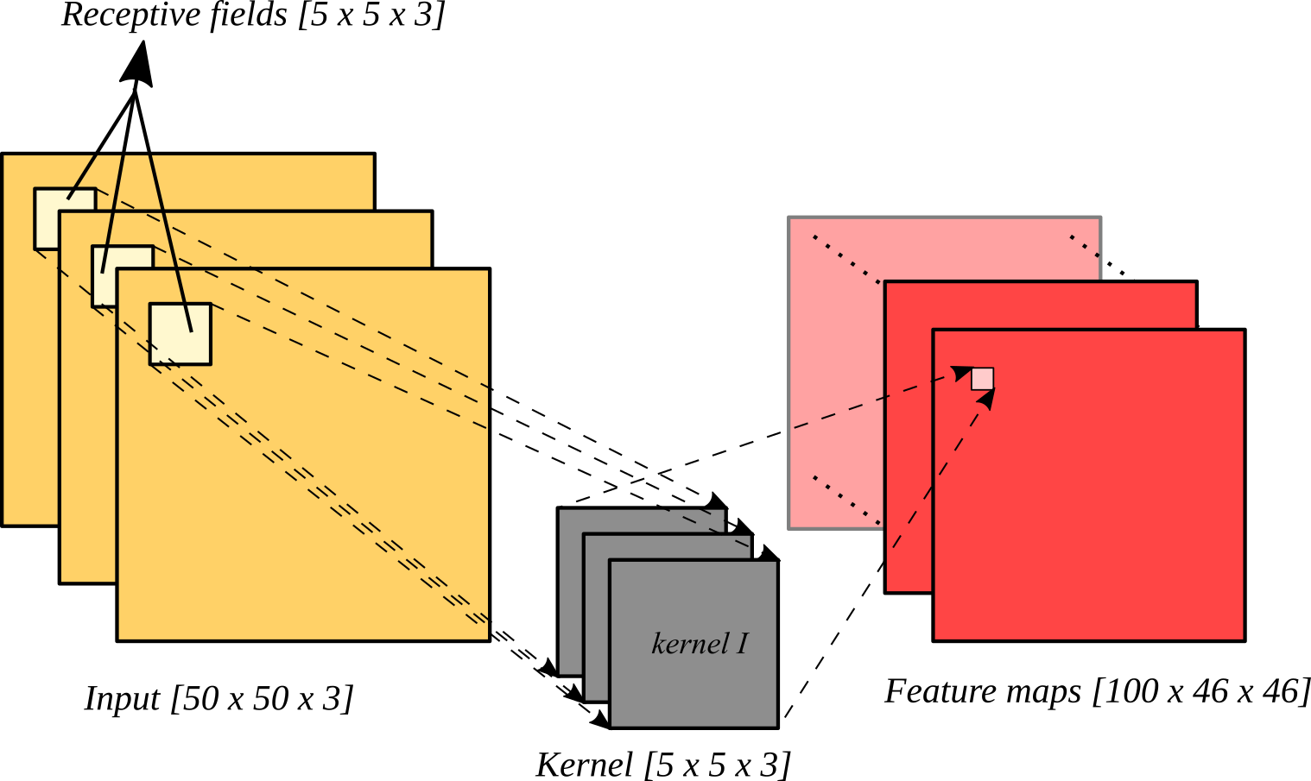
Feature maps and receptive fields
In the context of convolutional neural networks (CNNs), the receptive field refers to the region of the input image that a particular neuron in a convolutional layer is “looking at” or taking into account when making its predictions or feature extractions.
A "feature map" represents the output of a single filter applied to the input data, highlighting specific features like edges or textures within the image

Slide 39
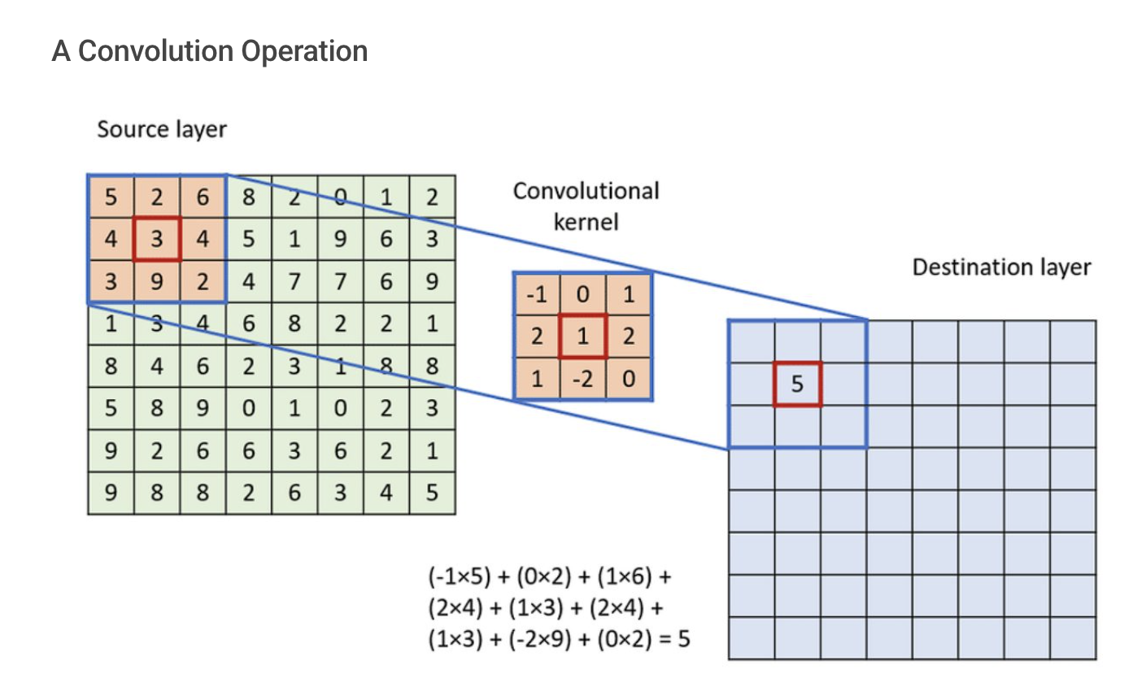
Convolutional Operations
In a Convolutional Neural Network (CNN), a convolution operation is a mathematical process where a "filter" (also called a kernel) slides across an input image, performing element-wise multiplication with a small region of the image (called the receptive field) at each position to extract specific features like edges, textures, or patterns, producing a new "feature map" as output.

Slide 40
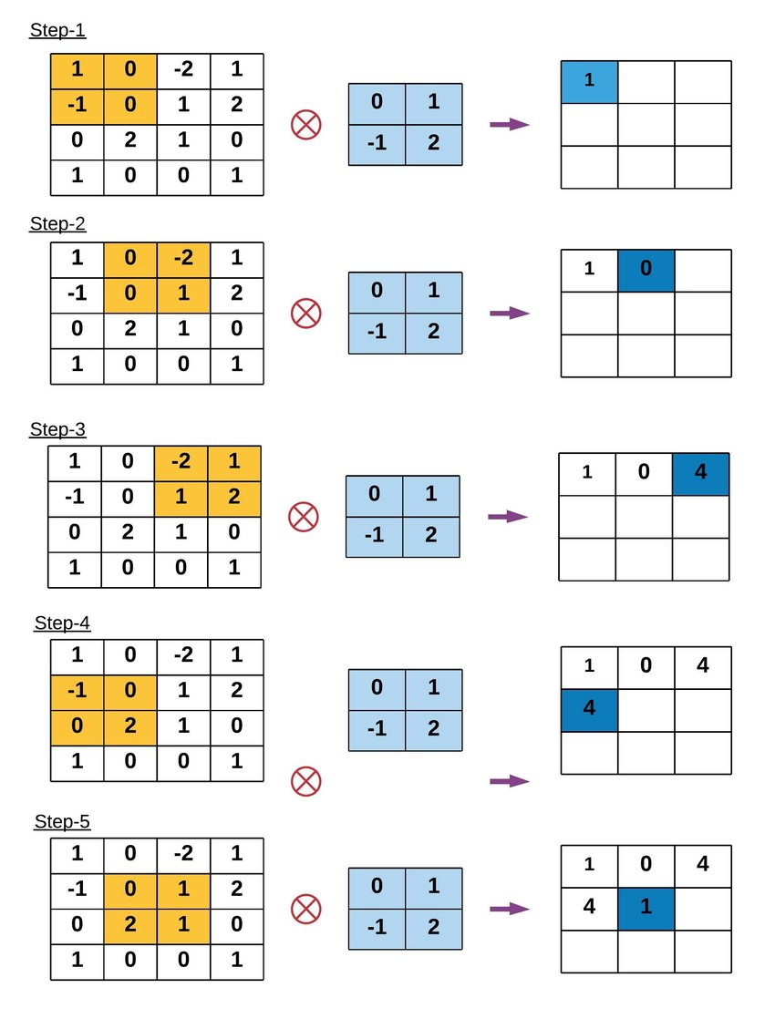
Example of Convolution
Operation

Slide 41
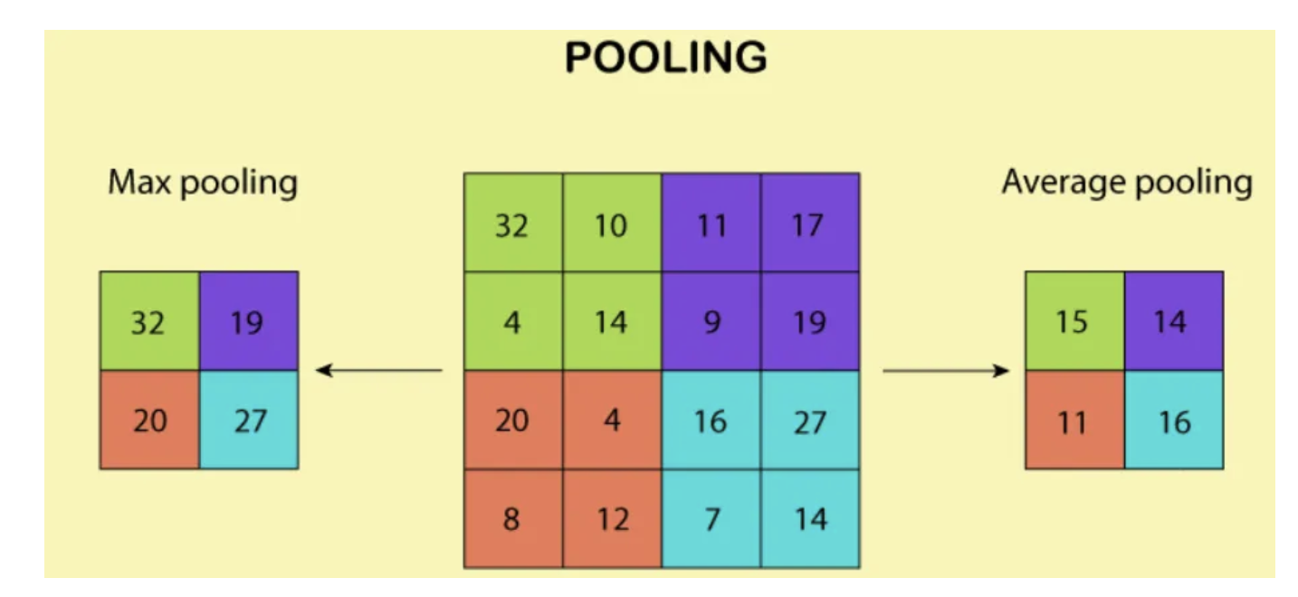
Pooling and Downsampling
The pooling layer is responsible for reducing the spatial dimensions of the feature maps produced by the convolutional layer.
It performs a down-sampling operation to reduce the size of the feature maps and reduce computational complexity.

Slide 42
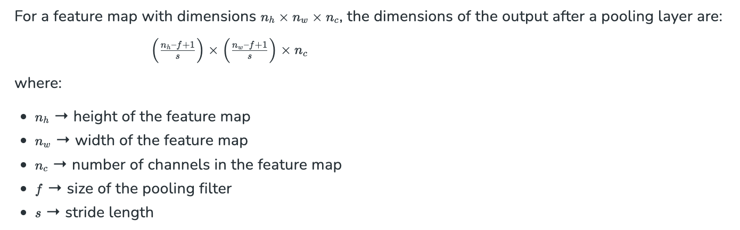

Slide 43
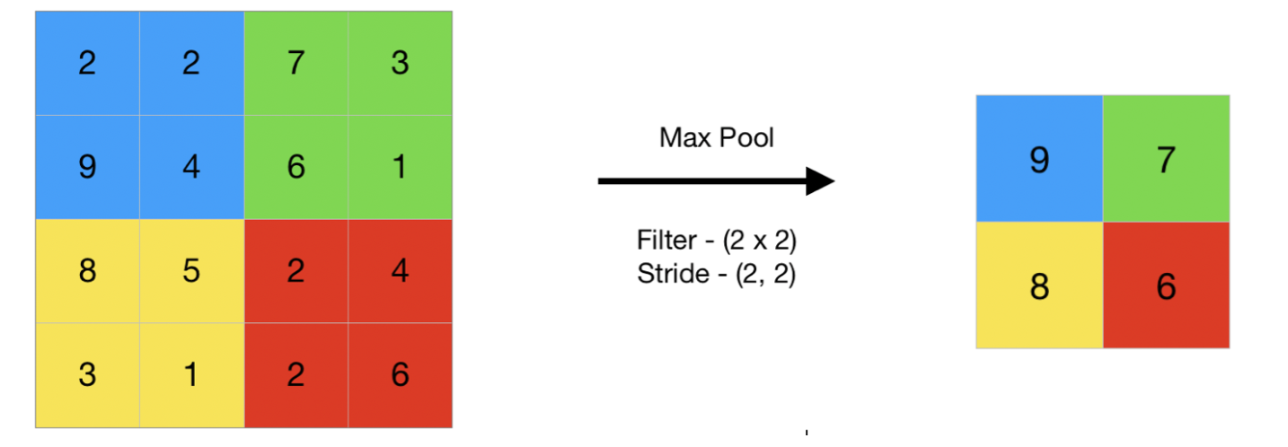
Types of Pooling Layers
1. Max Pooling
Max pooling selects the maximum element from the region of the feature map covered by the filter.
Thus, the output after max-pooling layer would be a feature map containing the most prominent features of the previous feature map.
Max pooling layer preserves the most important features (edges, textures, etc.) and provides better performance in most cases.

Slide 44
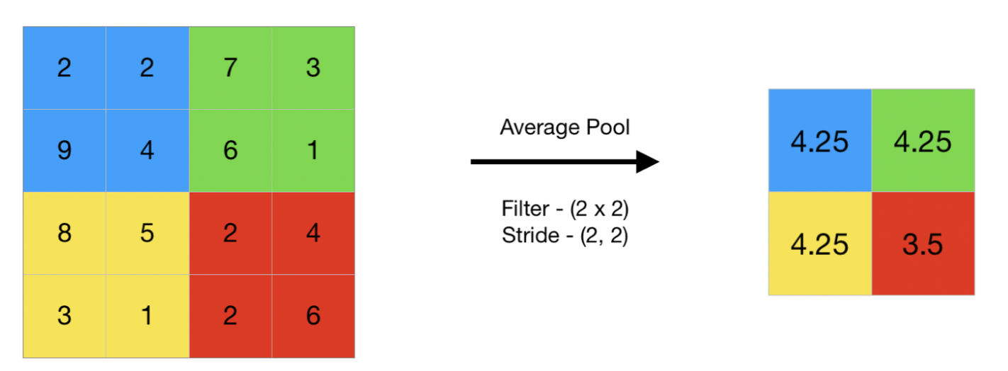
2. Average Pooling
Average pooling computes the average of the elements present in the region of feature map covered by the filter.
Thus, while max pooling gives the most prominent feature in a particular patch of the feature map, average pooling gives the average of features present in a patch.
Average pooling provides a more generalized representation of the input. It is useful in the cases where preserving the overall context is important.

Slide 45
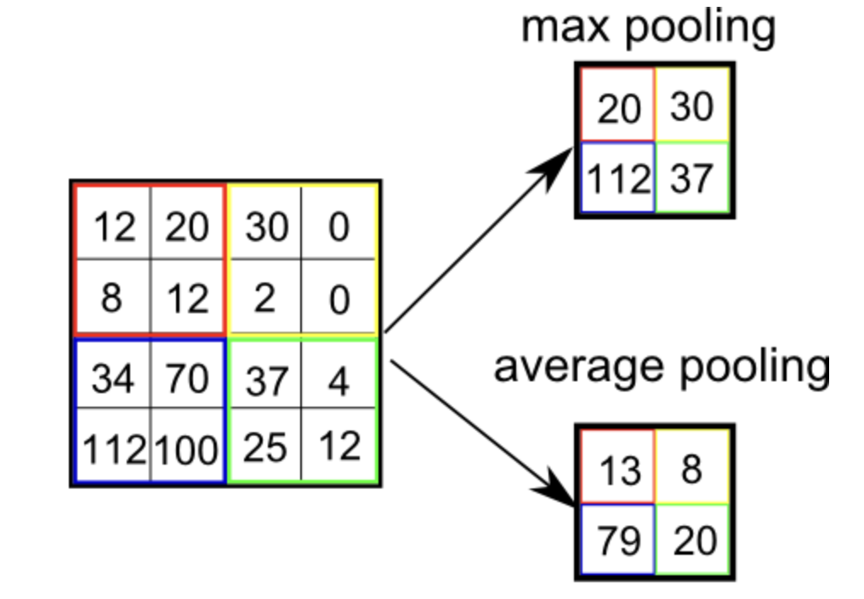

Slide 46
Aspect | Max Pooling | Average Pooling
Operation | Takes the maximum value from the pooled region. | Takes the average value of the pooled region.
Purpose | Focuses on capturing the most prominent features. | Focuses on capturing general patterns and smoothing.
Effect on Features | Emphasizes sharp, distinct features (edges, textures). | Emphasizes overall structure and smoother features.
Output | More sensitive to the presence of strong features. | Results in more general and averaged feature representations.
Common Use Case | Typically used in CNNs to detect key features like edges. | Less commonly used, but can be used for tasks requiring more subtle feature aggregation.
Computational Efficiency | More computationally efficient, as it only needs to find the max value. | Slightly more computationally expensive, as it requires summing values and dividing by the number of elements.
Sensitivity to Noise | More sensitive to outliers and noise in the data. | Less sensitive to noise, as it averages values.
Resulting Feature Map | Often results in smaller, more distinct feature maps. | Often results in smoother, less distinct feature maps.

Slide 47
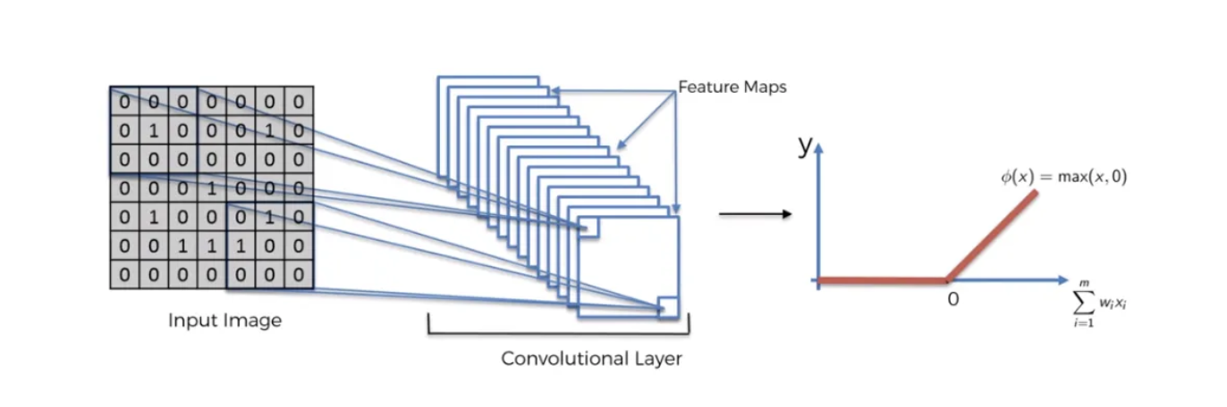
Activation Layer
The activation layer applies a non-linear activation function, such as the ReLU function, to the output of the pooling layer.
This function helps to introduce non-linearity into the model, allowing it to learn more complex representations of the input data.

Slide 48
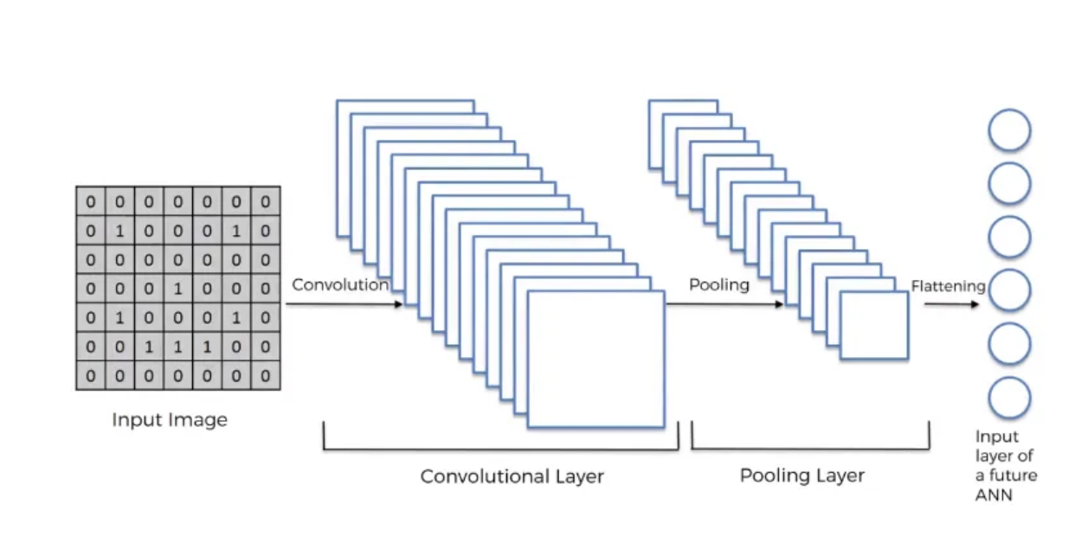
Fully Connected Layers and Classification
The fully connected layer is a traditional neural network layer that connects all the neurons in the previous layer to all the neurons in the next layer.
This layer is responsible for combining the features learned by the convolutional and pooling layers to make a prediction.

Slide 49
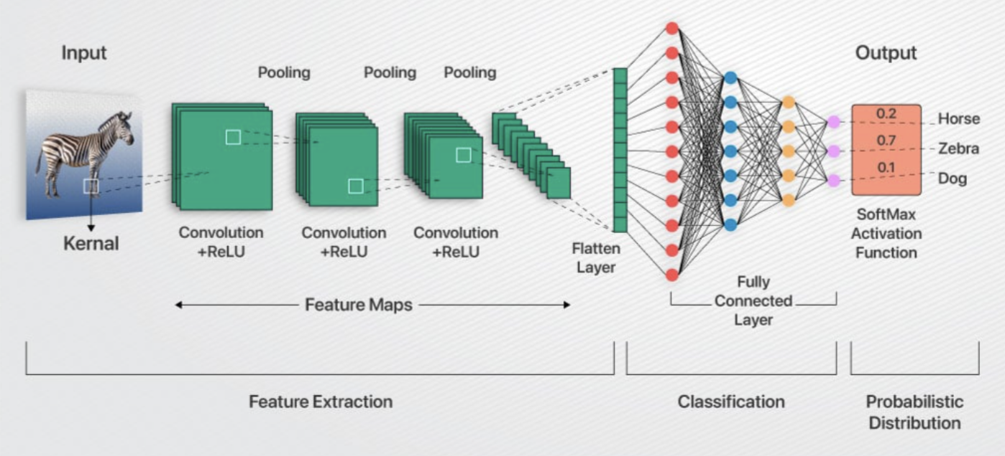

Slide 50


Slide 51
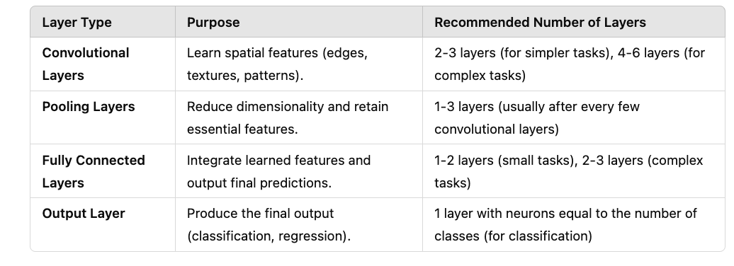
How do we know how many convolutional layers, how many pooling layers, and how many fully connected layer we should develop?
Determining the number of convolutional layers, pooling layers, and fully connected layers in a Convolutional Neural Network (CNN) depends on several factors, including the complexity of the task, the size of the dataset, the computational resources available, and the architecture design principles.

Slide 52

Overfitting and Regularization in CNNs

Slide 53

Limitations of Simple Convolutional Neural Network
Computational cost: Training a deep CNN can be computationally expensive, requiring significant amounts of data and computational resources.
Overfitting: Deep CNNs are prone to overfitting, especially when trained on small datasets, where the model may memorize the training data rather than generalize to new, unseen data.

Slide 54

Popular CNN Architectures

Slide 55
Introduction to Batch Normalization in Neural Networks

Slide 56

Batch Normalization in Deep Learning
Batch normalization is a technique used in deep learning to improve training speed and stability by normalizing the activations of each layer within a mini-batch.
It addresses the issue of internal covariate shift, where changes in the distribution of layer inputs during training can hinder learning.
By normalizing activations, batch normalization helps to ensure a more stable training process and allows for the use of higher learning rates, leading to faster convergence and improved model performance.

Slide 57
What is mini-batch?
In the context of batch normalization, a "mini-batch" refers to a subset of the overall training data used in each iteration of training.
Batch normalization normalizes the activations of each layer within a mini-batch during training, which helps to stabilize and accelerate the learning process.

Slide 58

Batch normalization is a layer that allows every layer of the network to do learning more independently.
It is used to normalize the output of the previous layers. The activations scale the input layer in normalization.
Using batch normalization learning becomes efficient also it can be used as regularization to avoid overfitting of the model.
The layer is added to the sequential model to standardize the input or the outputs. In simple terms by normalizing the layer weight as mean as 0 and standard deviation as 1.

Slide 59

What is Covariant Shift?
Covariate shift is a phenomenon in machine learning where the distribution of input features (covariates) changes between the training and testing or deployment phases of a model.
Essentially, the data your model sees during training is different from the data it encounters in the real world, potentially leading to poor performance.

Slide 60

How does Batch Normalization work?
Equations 2−4 describe how the mean and variance of each activation across a mini-batch is calculated, followed by subtraction by mean to zero centers the activations and dividing by the standard deviation. This is to make the standard deviation of each activation across the mini-batch unit (1).
Equation 5 is where the real magic happens. γ and β are the hyperparameters of the so-called batch normalization layer. The output of equation 5 has a mean of β and a standard deviation of γ. In effect, a batch normalization layer helps our optimization algorithm to control the mean and the variance of the output of the layer.

Slide 61

Batch Normalization in Keras

Slide 62
CNN-based Models:
LeNet-5

Slide 63

LeNet-5
LeNet is one of the oldest CNN models which paved the way for basis of convolution neural networks.
The leNet-5 network consists of seven layers: three convolutional layers, two pooling layers, and two fully connected layers.

Slide 64

Features of LeNet-5
Every convolutional layer includes three parts: convolution, pooling, and nonlinear activation functions
Using convolution to extract spatial features (Convolution was called receptive fields originally)
The average pooling layer is used for subsampling.
‘tanh’ is used as the activation function
Using Multi-Layered Perceptron or Fully Connected Layers as the last classifier
The sparse connection between layers reduces the complexity of computation.

Slide 65








Slide 66

LeNet-5 Keras Implementation

Slide 67
CNN-based Models: AlexNet

Slide 68

CNN-Based Model: AlexNet
AlexNet consists of 5 convolution layers, 3 max-pooling layers, 2 Normalized layers, 2 fully connected layers and 1 SoftMax layer.
Each convolution layer consists of a convolution filter and a non-linear activation function called “ReLU”.
The pooling layers are used to perform the max-pooling function on and the input size is fixed due to the presence of fully connected layers.
The input size is 224x224x3 but due to some padding which happens it works out to be 227x227x3.
Above all this AlexNet has over 60 million parameters.

Slide 69


Slide 70


Slide 71


Key Features:
‘ReLU’ is used as an activation function rather than ‘tanh’
Batch size of 128
SGD Momentum is used as a learning algorithm
Data Augmentation is been carried out like flipping, jittering, cropping, color normalization, etc.
Augmentation by Mirroring
Augmentation by Random Cropping of Images

Slide 72


Slide 73


Slide 74
CNN-based Models: ResNet

Slide 75

CNN-based Model: ResNet
The previous CNN models deal with some issues:
Difficulty in training deep neural networks: As the number of layers in a model increases, the number of parameters in the model increases exponentially.
More expressive, less different: A neural network is often considered to be a function approximator. It has the ability to model functions given input, target and a comparison between the function output and target. Adding multiple layers into a network makes it more capable to model complex functions.
Vanishing/Exploding Gradient

Slide 76


Reminder
Vanishing Gradient Problem
It occurs when the gradients of the loss function with respect to the parameters (weights) become very small during backpropagation, effectively preventing the weights from updating properly.
Exploding Gradient Problem
The gradient keeps on getting larger and larger as the result backpropagation algorithm progresses, it causes very large weight updates and causes the gradient descent to diverge.

Slide 77

CNN-based Model: ResNet
ResNet (Residual Network) is a powerful convolutional neural network architecture that has revolutionized the field of deep learning.
ResNet addresses the problem of vanishing gradients that often occur in very deep neural networks. When a neural network has many layers, the gradients can become very small, which makes it difficult for the network to learn.
ResNet solves this problem by introducing shortcut connections, also known as skip connections, that allow the network to skip over certain layers and directly propagate the input to deeper layers.
This helps to preserve the gradient and make it easier for the network to learn.

Slide 78


Slide 79

ResNets Architecture with
Different Numbers of Layers

Slide 80

What are Skip Connections?
In ResNet (Residual Neural Network) architectures, skip connections, also known as Shortcut connection, are a crucial design element that allows information to bypass one or more layers of the network.
This bypassing is achieved by adding the input of a layer directly to its output, creating a "shortcut" for the data to travel through the network.
This technique addresses the Vanishing gradient problem and allows for the training of much deeper networks than traditional architectures.

Slide 81

Skip Connection is a direct connection that skips over some layers of the model. The output is not the same due to this skip connection. Without the skip connection, input ‘X gets multiplied by the weights of the layer followed by adding a bias term.
Then comes the activation function, F() and we get the output as :
F( w*x + b ) =F(X)
But with skip connection technique, the output is :
F(X)+x

Slide 82

What are residuals in ResNet?
In ResNet (Residual Network), residuals refer to the "skip connections" that bypass one or more layers in the network, effectively adding the input of a layer or block to its output.
This technique allows the network to learn the "residual" or difference between the input and the desired output, making it easier to train very deep networks and mitigating the vanishing gradient problems.

Slide 83

Let us pick the Conv3_x block and try to understand what is happening inside it.
Convolution Block
A Convolution Block is used when the dimensions (shape) of the input and output differ, either due to:
A change in the spatial size (height and width of the feature map).
A change in the number of channels.
Identity Block
An Identity Block is used when the dimensions (shape) of the input and output are the same, allowing the input to be directly added to the output without any transformation.

Slide 84
CNN-based Models: VGG

Slide 85

CNN-based Model: VGG
VGG (Visual Geometry Group) models are a family of convolutional neural networks (CNNs) known for their deep architecture and effectiveness in image recognition tasks.
The most popular VGG models are VGG16 and VGG19, which have 16 and 19 weight layers, respectively.

Slide 86


Slide 87

VGG-16 vs VGG-19 Architecture

Slide 88


Slide 89

Example:

Slide 90
Introduction to CapsNet

Slide 91

CapsNet
A Capsule Network is just a neural network that improves the design of CNNs by the following key changes:
Capsules
Dynamic Routing, routing by agreement, and Coupling Coefficients
Squashing Function
Margin Loss Function

Slide 92


Slide 93

What is a capsule?
At the core of Capsule Networks is the concept of a capsule, which is simply a collection of neurons. This set of neurons, called a capsule, outputs a vector.

Slide 94


Slide 95

What is Dynamic Routing?
Convolutional Neural Networks (CNNs) primarily focus on just the individual features within an image.
In contrast, Capsule Networks understand the relationship between individual parts of an object and the entire object. It knows how parts of an object combine to form the actual object, also called the part-whole relationship. This is possible due to the dynamic routing process.
The dynamic routing process ensures that lower-level capsules (representing parts of objects) send their output vectors to the most appropriate higher-level capsule (representing the whole object). This allows the network to learn spatial hierarchies in turn.

Slide 96

What is a Coupling Coefficient?
Coupling coefficients (cij) are scalar values that determine the strength of the connection between a lower-level capsule and a higher-level capsule.
They play a crucial role in the dynamic routing process by guiding the amount of output from the lower-level capsules sent to each higher-level capsule.
The dynamic routing algorithm updates cij indirectly by the scalar product of votes and outputs of possible parents.

Slide 97

What is the Squashing Function?
The squashing function is a nonlinear function that squashes a vector between 0 and 1.
Short vectors get shrunk to almost zero length, and long vectors get shrunk to a length slightly below 1.
This allows the length of the vector to act as a probability or confidence measure of the feature’s presence, without losing the vector’s direction.

Slide 98
What is the Margin Loss Function?
In Capsule Network, to accommodate vector outputs, a new loss function is introduced: the margin loss function.
Lk: The loss for capsule k.
Tk: A binary indicator that is 1 if the digit class k is present in the image, and 0 if it is not. This allows the network to distinguish between digits that are present and those that are not.
∣∣vk∣∣: The magnitude (or length) of the output vector of capsule k. This length represents the network’s confidence that the digit class k is present in the input.
λ: A weighting factor (set to 0.5) is used to down-weight the loss for digit classes that are not present. This prevents the network from focusing too much on minimizing the presence of absent digit classes, especially early in training.
The total loss for an input is the sum of the Marginal Losses (Lk) across all digit capsules. This approach allows the network to learn to correctly adjust the lengths of the instantiation vectors for each capsule, corresponding to each possible digit class.

Slide 99

Computations inside of a capsule

Slide 100

Training A Capsule Network

Slide 101
Step 1: Forward Pass
Preprocessing and Initial Feature Extraction: The first layer of the Capsule Network is a convolution layer that extracts features like edges and texture and passes them forward to the capsule layer.
Primary Capsule Layer: This is the first capsule layer. Here, local features detected by the convolutional layers are transformed into vectors by the capsules. Each capsule in this layer aims to capture specific features or parts of an object, with the vector’s direction representing the pose or orientation and the length of the vector indicating the probability of the feature’s presence.
Squashing Function: The squashing function preserves the direction of the vector, but shrinks the vector between 1 and 0, indicating the probability of a feature’s presence.
Dynamic Routing: The dynamic routing algorithm decides which higher-level capsule receives outputs from the initial capsules.
Digit Capsules: The capsule network’s final layer, known as the digit capsule, uses the output vector’s length to indicate the digit present in the image.

Slide 102

Step 2: Backpropagation
Margin-based Loss Functions: This function penalizes the network when the agreement between a capsule and its most likely parent (based on pose) is not significantly higher than the agreement with other potential parents. This indirectly encourages the routing process to favor capsules with stronger pose agreement.
Weight Updates: Using the calculated loss and gradients, the weights of the neurons in the capsules are updated.
For multiple epochs over the training dataset, the process repeats the forward pass and backpropagation steps, refining the network’s parameters each time to minimize the loss.

Slide 103
Introduction to PyTorch

Slide 104

What is PyTorch?
PyTorch is an open-source machine learning framework primarily used for building and training deep learning models. Developed by Meta (formerly Facebook), it has gained significant popularity in both research and production environments due to its flexibility and ease of use.
Note: Please refer to https://pytorch.org/ for more details.

Slide 105


Slide 106


Installing PyTorch and Start Working….
Installation Pytorch
Check Installation

Slide 107

Defining Model in PyTorch
Defining a model in PyTorch involves creating a class that inherits from torch.nn.Module.
Steps to Define a Model in PyTorch:
Import Required Libraries
Subclass nn.Module
Define the Layers in __init__
Define the Forward Pass in forward()

Slide 108

1.1 Importing Necessary Libraries
First, we import the necessary libraries to define the model. Specifically, we import torch.nn for defining neural network layers and torch for tensor operations.

Slide 109

1.2 Subclassing ( torch.nn.Module)
To define a custom model in PyTorch, you subclass nn.Module.
Step-by-Step: Subclassing nn.Module
Create a new class that inherits from nn.Module.
Initialize layers in the __init__ method.
Define the forward pass in the forward() method.

Slide 110

Different types of Layers in PyTorch
Fully Connected (Dense) Layer - nn.Linear
Convolutional Layer - nn.Conv2d, nn.Conv1d
Pooling Layer - nn.MaxPool2d, nn.AvgPool2d
Activation Layer - nn.ReLU, nn.Sigmoid, nn.Tanh
Dropout Layer - nn.Dropout
Batch Normalization Layer - nn.BatchNorm2d, nn.BatchNorm1d
Recurrent Layers - nn.RNN, nn.LSTM, nn.GRU
Embedding Layer - nn.Embedding
Flatten Layer - nn.Flatten
Linear Activation Layer (Output Layer for Regression) - nn.Linear

Slide 111

1.3 Initializing the Model, loss function, and optimizer
1. Loss Functions:
nn.MSELoss (Mean Squared Error Loss)
nn.BCELoss (Binary Cross-Entropy Loss)
nn.NLLLoss (Negative Log Likelihood Loss)
nn.MultiMarginLoss (Hinge Loss)
nn.SmoothL1Loss (Huber Loss)
nn.CrossEntropyLoss (Cross-Entropy Loss for multi-class classification)
2. Optimizers:
optim.Adam
optim.RMSprop
optim.Adagrad
optim.Adadelta
optim.SGD

Slide 112

1.4 Model Training

Slide 113

1.5 Model Evaluation
Note:
torch.no_grad(): This context manager tells PyTorch not to track gradients during evaluation (which is unnecessary and saves memory).
torch.max(outputs, 1): Gets the index of the highest logit (i.e., the predicted class).
correct: Tracks the number of correct predictions.
total: Tracks the total number of samples.
accuracy: Computes the accuracy of the model on the test set.

Slide 114
Example 1

Slide 115

Example: PyTorch DNN on Iris Dataset

Slide 116


Slide 117



Slide 118
Example 2

Slide 119

Example : PyTorch CNN on MNIST

Slide 120


Slide 121



Slide 122


Slide 123


